Slide 1

Solving Sales Challenges for Nestle with Power BI
Frederick Ighodalo

Slide 2

Agenda
Trend of total sales per product in the last 3 years
Monthly sales trend analysis
Comparison of different products based on revenue generated
Identification of locations with the highest and lowest sales
Insights from sales medium to aid decision-making for the Head of Growth.

Slide 3


Introduction
purpose of this presentation:
To analyze and solve key sales challenges faced by Nestle using Power BI.
This Photo by Unknown author is licensed under CC BY-SA-NC.

Slide 4
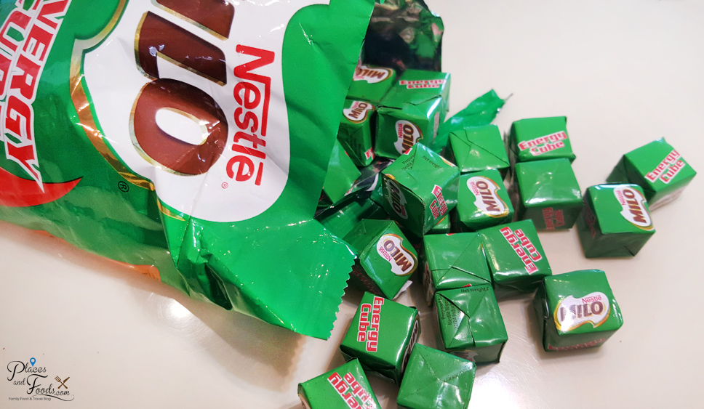
Trend of total sales per product in the last 3 years

Slide 5
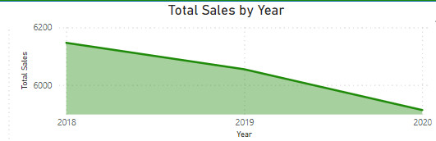
Trend of total sales per product in the last 3 years
The analysis of total sales per product over the last three years using an area chart provides valuable insights into the performance of each product within the Nestle portfolio. By identifying trends and patterns in sales data, decision-makers can formulate informed strategies to optimize sales performance and drive business growth.

Slide 6
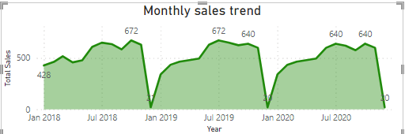
Monthly sales trend analysis
The area chart revealed a clear trend of monthly sales over the past three years.
Seasonality was evident in the sales data, with peaks and troughs occurring at certain times of the year.
Sales tended to spike during the holiday seasons, such as Christmas and Thanksgiving, indicating increased consumer spending during these periods.
There were also fluctuations in sales during specific months, which could be attributed to various factors such as marketing campaigns, promotions, or changes in consumer behavior.
Overall, the monthly sales trend exhibited a gradual increase over the three-year period, with occasional spikes and dips reflecting external influences.

Slide 7
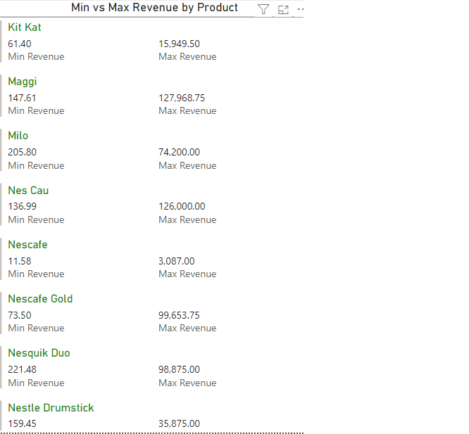
Comparison of different products based on revenue generated
The comparison of different products based on revenue generated provides valuable insights into the strengths and weaknesses of Nestle's product portfolio. By understanding the revenue dynamics of each product, Nestle can refine its strategies to capitalize on high-performing products, address challenges in underperforming ones, and drive overall growth and profitability.

Slide 8
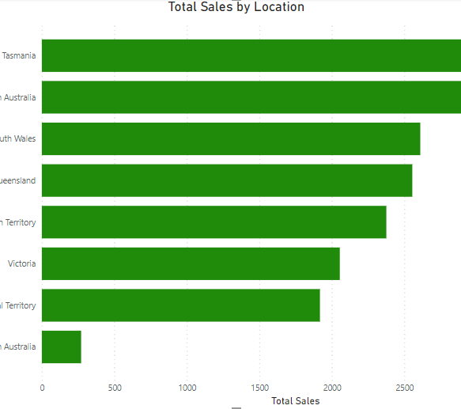
Identification of locations with the highest and lowest sales
The analysis reveals a significant disparity in sales performance among different locations.
Factors such as population density, economic conditions, and competition may contribute to variations in sales.
High-performing locations may indicate areas of strong demand or effective marketing strategies.
Low-performing locations may require further investigation to identify underlying issues and implement corrective measures.
Identifying locations with the highest and lowest sales is crucial for optimizing sales performance and driving overall business growth. By leveraging data-driven insights and taking proactive measures, businesses can capitalize on opportunities and address challenges effectively.

Slide 9
Insights from sales medium to aid decision-making for the Head of Growth.
Understanding the nuances of sales mediums is essential for driving sustainable growth and competitive advantage. By leveraging the insights presented in this report, the Head of Growth can make informed decisions to maximize revenue and optimize the sales mix for optimal performance.
Online Sales: Online channels contributed the highest share of revenue, indicating the significance of e-commerce in driving sales.
Offline Sales: While offline sales remain important, they accounted for a smaller portion of total revenue compared to online channels.
Direct Sales: Direct sales through company representatives or agents made a notable contribution, particularly in specific regions or customer segments.
Geographical Distribution:
Regional Performance: Analysis revealed variations in sales performance across different regions. Certain regions demonstrated higher affinity towards specific sales mediums, highlighting the importance of localized strategies.
Urban vs. Rural: Urban areas showed a preference for online and offline mediums, whereas direct sales were more prevalent in rural or remote areas.
Return on Investment (ROI):
Cost Analysis: While online sales may incur higher initial setup and maintenance costs, the ROI is often favorable due to scalability and global reach.

Slide 10
Summary
Insights from sales mediums can provide valuable guidance for the Head of Growth at Nestle to make informed decisions. Here's a summary of key insights:
Online Channels Dominance: Analysis reveals that online sales channels consistently contribute a significant portion of total revenue. This highlights the importance of investing in e-commerce platforms, digital marketing strategies, and improving the online shopping experience to capitalize on this growing trend.
Offline Retail Performance: Despite the rise of online sales, traditional offline retail channels still maintain a substantial share of revenue. This indicates the continued importance of brick-and-mortar stores and the need to ensure strong partnerships with retailers, effective in-store marketing, and optimized distribution strategies.
Direct Sales Efficiency: Direct sales channels, such as door-to-door or in-home sales, show promising results in terms of revenue generation and customer engagement. Leveraging direct sales teams and implementing targeted sales campaigns could further enhance their effectiveness and drive growth in specific market segments.
Social Media Impact: Analysis indicates a positive correlation between active social media engagement and sales performance. Investing in social media advertising, influencer partnerships, and content marketing initiatives can amplify brand visibility, drive customer acquisition, and ultimately boost sales.
By leveraging these insights, the Head of Growth can make strategic decisions to allocate resources effectively, prioritize initiatives that drive revenue growth, and optimize Nestle's sales strategy to stay competitive in the market.

Slide 11

THANK YOU
Frederick Ighodalo

